Slide 1
Distributed Federated Service Chaining for Heterogeneous Network Environment
By
Chen Chen, Dr. Lars Nagel, Dr. Posco Tso
Department of Computer Science
Loughborough University

Slide 2
Outline
Background
Motivation
Research Problem
Experiment Results
Conclusion
Notes:
The description of the topic

Slide 3
Background
Edge computing, IoT devices
Multiple stakeholders
Multi-domain
Data center, ISP network and edge
Multiple business objectives

Slide 4
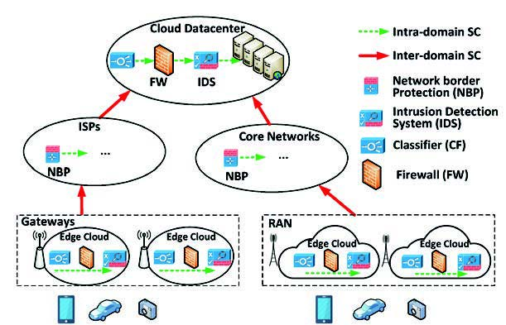
Background
Service Function Chaining (SFC)
A set of service functions
In predefined order
Subsequent traffic steering
Source: L Cui, F Tso, and W Jia. Federated service chaining: Architecture and
challenges. 58(3):47–53, March 2020.

Slide 5
Motivation
Domain autonomy and privacy
Reduce decision-making time
Notes:
The description of the topic

Slide 6
Motivation
An example of centralized framework
Notes:
The description of the topic

Slide 7
Motivation
?
?
?
An example of distributed framework
Notes:
The description of the topic

Slide 8
Research Problem
Place vNFs ?
Route the traffic ?
An Integer Linear Programming problem
Minimize the deployment cost
Notes:
The description of the topic

Slide 9
Solution
Physical topology
Aggregated topology

Slide 10
Solution
Step 1: Assign vNFs to domains
Orchestrator 1
K-shortest path algorithm
Acc. to resource price

Slide 11
Solution
Step 2: Single-domain deployment
K-shortest path algorithm
First-fit node

Slide 12
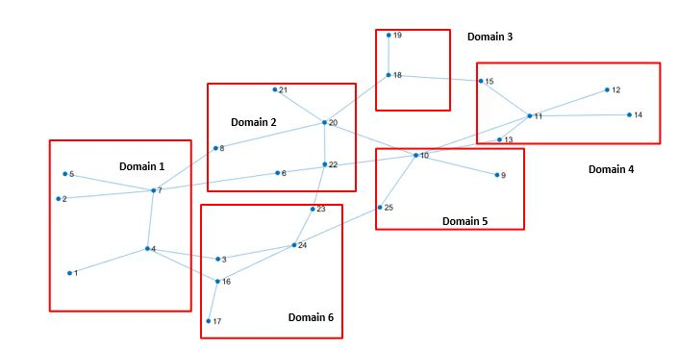
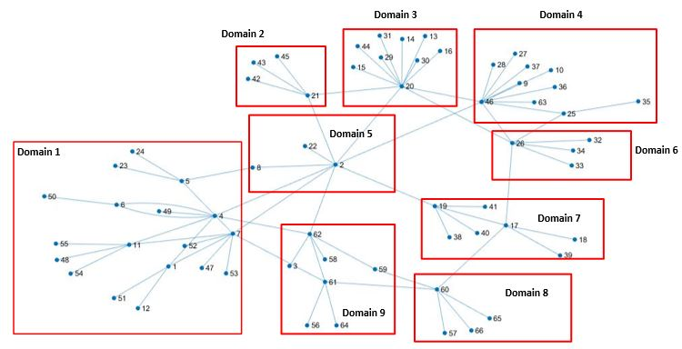
Experiment Results
Topology
Agis
Internode
Notes:
The description of the topic

Slide 13
Experiment Results
DFSC: Distributed Federated Service Chaining
SFCO-AMD: SFC Orchestration Across Multiple Domains
Gurobi: Optimization solver
Source: G Sun, Y Li, D Liao, and V Chang. Service function chain orchestration across multiple domains: A full mesh aggregation approach. IEEE Transactions on Network and Service Management, 15(3):1175–1191, sep 2018.

Slide 14
Experiment Results
Cost ratio in Agis topology

Slide 15
Experiment Results
Decision-making time (s) in Agis topology

Slide 16
Experiment Results
Cost ratio in Internode topology

Slide 17
Experiment Results
Decision-making time (s) in Internode topology

Slide 18
Conclusion
Distributed and scalable
Domain autonomy and privacy
1.15 times to the optimum
Reduce 12% deployment cost
One order of magnitude faster
Notes:
The description of the topic

Slide 19
Thank you for your attention !!
Notes:
The undergraduate student /

Slide 20
Reference
[1] Deval Bhamare, Mohammed Samaka, Aiman Erbad, Raj Jain, Lav
Gupta, and H. Anthony Chan. Optimal virtual network function placement
in multi-cloud service function chaining architecture. Computer
Communications, 102:1 – 16, 2017.
[2] Richard Cziva, Christos Anagnostopoulos, and Dimitrios P. Pezaros.
Dynamic, Latency-Optimal vNF Placement at the Network Edge. In
Proceedings - IEEE INFOCOM, volume 2018-April, pages 693–701.
Institute of Electrical and Electronics Engineers Inc., oct 2018.
[3] David Dietrich, Ahmed Abujoda, Amr Rizk, and Panagiotis Papadimitriou.
Multi-Provider Service Chain Embedding With Nestor. IEEE
Transactions on Network and Service Management, 14(1):91–105, mar
2017.
[4] Racha Gouareb, Vasilis Friderikos, and Aghvami. Virtual Network
Functions Routing and Placement for Edge Cloud Latency Minimization.
IEEE Journal on Selected Areas in Communications, 36(10):2346–2357,
oct 2018.
[5] Ines Houidi, Wajdi Louati, Walid Ben Ameur, and Djamal Zeghlache.
Virtual network provisioning across multiple substrate networks. Computer
Networks, 55(4):1011–1023, 2011.
[6] Walter Johnston, Kevin Sparks, Brian Daly, Russ Gyurek, Kumar
Balachandran, John Barnhill, Lynn Merrill, Brian Markwalter, Adam
Drobot, Jeff Foerster, and Dale Hatfield. 5G EDGE COMPUTING
WHITEPAPER. Technical report.
Notes:
The description of the topic

Slide 21
Background
 | Traditional SFC | Federated SFC
Stakeholders
Complexity
Consistency
Flexibility
Troubleshooting
Single
Multiple
One controller
Multiple controllers
Easy
Interoperation
Single domain
Multiple domains
Easy
Difficult
Source: L Cui, F Tso, and W Jia. Federated service chaining: Architecture and
challenges. 58(3):47–53, March 2020.
Notes:
The description of the topic

