Slide 1
Subjective Quality Assessment of Cloud Gaming
Abdul Wahab and Dr John Schormans
School of Electronic Engineering and Computer Science

Slide 2
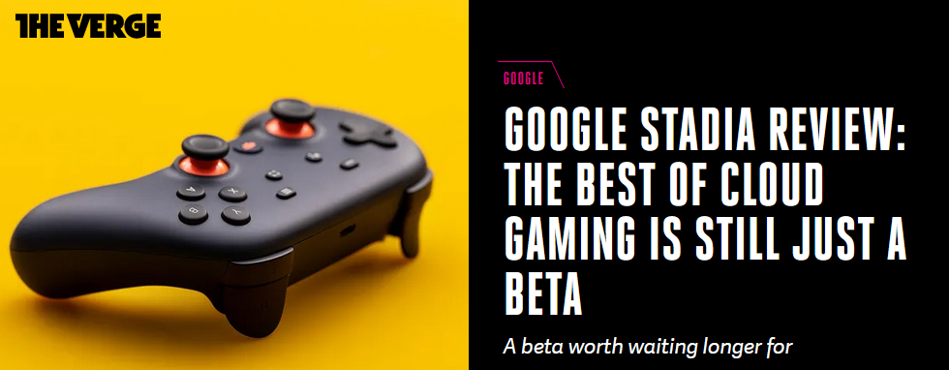
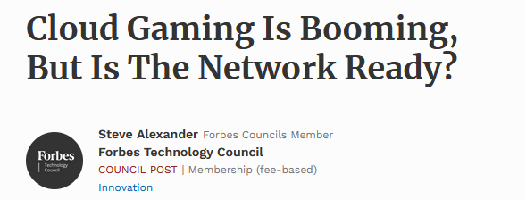
Motivation
Emerging application with a prospective $1B+ market cap by 2021 (statista,2021)
Major service providers have millions of subscriptions and growing

Slide 3
What is cloud gaming?
Gaming-as-a-Service (Gaas)
Thin client with low or no GPU
Cloud gaming server
Cloud gaming client
User-action reception
Transport
Network
Video capture
Game logic implementation
Decoding
Frame rendering
User action capture
Hardware/software video encoding

Slide 4
Research Problems
How does network-level Quality of Service (QoS) affect the Quality of Experience (QoE) of popular games on cloud gaming platforms?
Are the subjective video quality and game quality same or different?

Slide 5
Methodology
Game
Selection
QoS
implementation
Subjective
Testing
Genre
Content complexity
Pace
Popularity
Learning difficulty
NetEM modification
Delay Only
PLR Only
Mixed (delay + PLR)
32 subjects
Each ranking 39 x 3 scenarios on ACR.
Video quality
Game quality
Overall quality

Slide 6
Game Selection
Content Complexity
Pace
Genre
Action – Adventure
Grand Theft Auto V
Mafia
Red dead redemption
High SITI
Grand Theft Auto V
Red dead redemption
High
Grand Theft Auto V
Intermediate
Counter Strike global offensive
First person shooting
Battlefield V
Counter Strike global offensive
Call of duty
Intermediate SITI
Counter Strike global offensive
Call of duty
Low
FIFA 2020
Sports
Forza
FIFA 2020
Rocket League
Low SITI
Forza
FIFA 2020

Slide 7
QoS implementation
Three classes of scenarios implemented:
Delay only
PLR only
Mixed (delay + PLR)
Table: Summary of Network parameters implemented in NetEM

Slide 8
NetEm modifications
Realistic Delay distributions implemented using iproute2 and custom tables.
Empirical correlation between PLR and delay implemented.

Slide 9
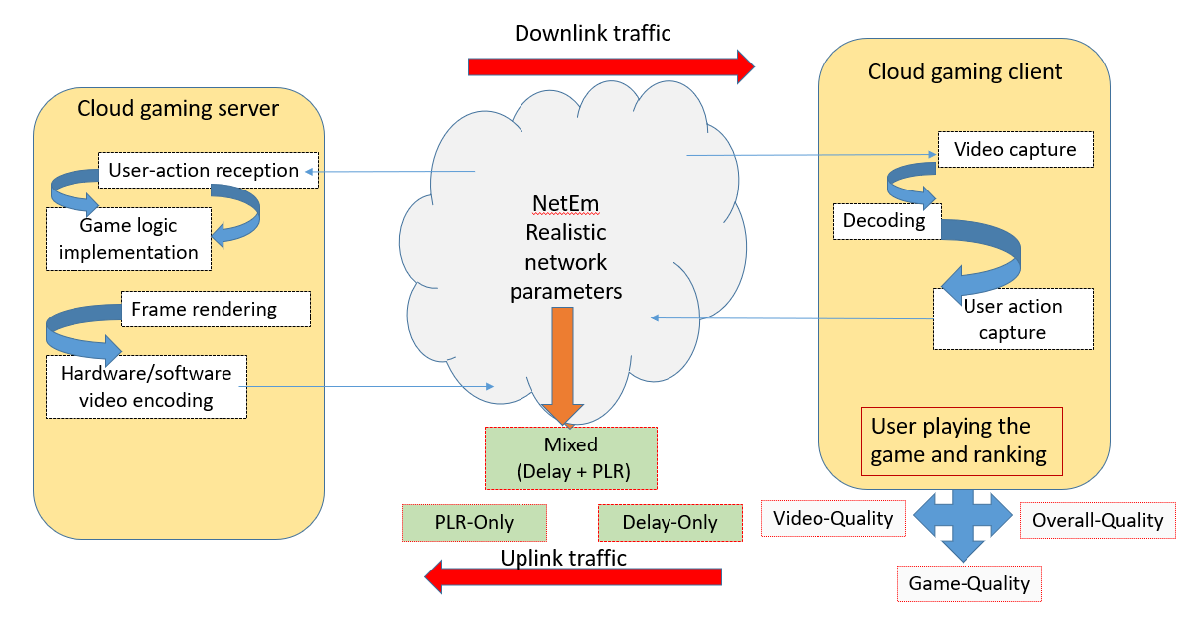
Subjective Testing testbed

Slide 10
Results: Delay only scenarios
Game with high content complexity and pace gets affected more by increasing delay.

Slide 11
Results: PLR only scenarios
Game with high content complexity and pace gets affected more for increasing PLR.

Slide 12
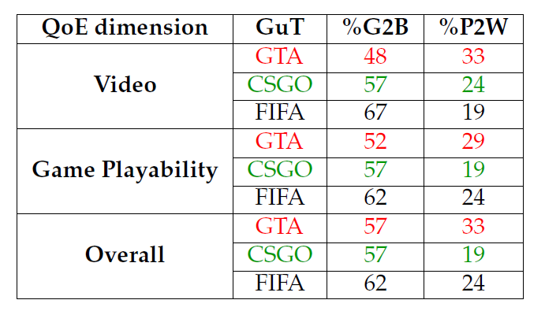
Results: Mixed scenarios
Good-2-better (%G2B) > 4 MOS
Poor-2-Worse (%P2W) < 3 MOS
So far video and game quality are closely related but different.
Table: %G2B and %P2W of QoE dimensions for GuTs

Slide 13
Video and Game Quality: Same or Different?
Using MOS alone: they show differences.
Shortcoming of MOS.
Distribution analysis using Wilcoxon Sign Rank (WSR) Test
91% times the difference between Video and Game quality are not significant.

Slide 14
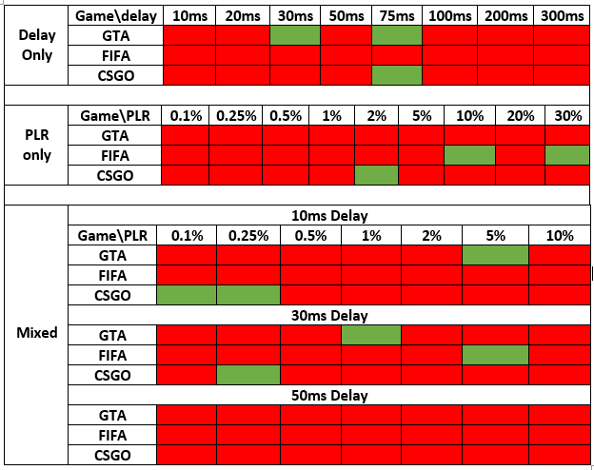
Video and Game Quality: Same or Different?
Results of WSR test
Red: Not significantly different.
Green: Significantly different

Slide 15
Conclusion
Game with higher pace and content complexity perform worse at degrading network conditions
Network tuning with QoE management is important.
Subjective game and video quality are not significantly different.
Steppingstone for objective QoE metric for cloud gaming.

Slide 16
Thank You for listening!

