Slide 1
Challenged Communication:
Shifting Perspectives, and Obstacles to Opportunities.

Slide 2
“All available data will be transmitted.” – FALSE!
Even delay-tolerance assumes eventual transmission!
Future Internet: Can no longer afford to assume channel persistence/sufficiency.
Apps: Sensor, off-loading,
actuation/control, others?
Goal in Haiku-ish:
To engage with apps
To transmit the right info
When all data impossible.
application
presentation
session
transport
network
datalink
physical

Slide 3
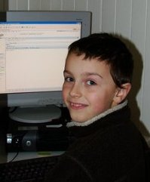
The Forgotten: Rural, Remote, and Under-serviced
“No market, no expertise.” – existing models fail.
Requires new ‘user-driven’ networking approaches,
In education
In network management
In operational models, etc.
Interdisciplinary and intra-disciplinary by nature,
HCI, data mgmt, machine learning
No networking obstacles; lots of networking opportunities!
SDN, transport, resource sharing…

