Slide 1
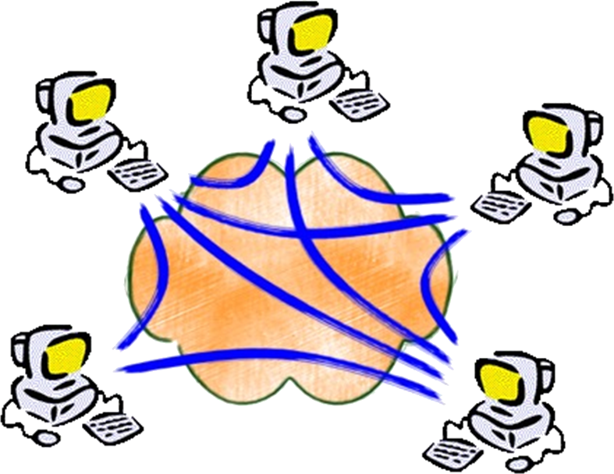
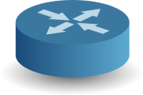
Mismatch between Apps & Data Centre Network
Abstraction
Reality
Oversubscription: Fat-tree [SIGCOMM’08], VL2 [SIGCOMM’09], …
Path collision: Hedera [NSDI’10], MPTCP [SIGCOMM’11], SPAIN [NSDI’10], …
TCP Incast: DCTCP [SIGCOMM’10], ICTCP [CoNEXT’10], …
Traffic prioritisation: Orchestra [SIGCOMM’11], D2TCP [SIGCOMM’11], …
Fair sharing: Seawall [NSDI’11], FairCloud [SIGCOMM’12], …
Treating symptoms rather than cause...
Many proposals for software-based routers and switches
  e.g. RouteBricks , ServerSwitch, PacketShader, SideCar, NetMap,…
Replace traditional, application-agnostic network services
    e.g. IPv4 forwarding, deep packet inspection, firewalls
Why don’t use them to implement application-specific services?

Slide 2





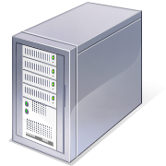
EPSRC NaaS Project: Network-as-a-Service
Switches augmented with processing capabilities (NaaS box)
  Applications deploy processing functions on each device
  Permits applications to adapt network flows based on requirements
Initial use case: on-path data aggregation for Hadoop
  Other use cases: content-based routing, in-network caching, ...
Research challenges: performance, isolation, programming model

