Slide 1
Converged (and Adaptive) Resource Provisioning for Converged ICT
Dimitrios Pezaros
University of Glasgow
dimitrios.pezaros@glasgow.ac.uk

Slide 2
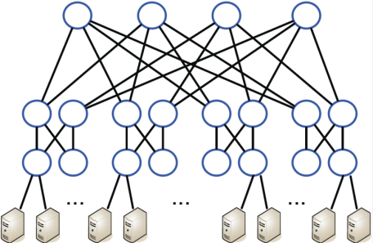
Converged ICT over Cloud Data Centres
Converged infrastructures collocating compute, network, storage services and resources
Inexpensive individual equipment; horizontal expansion; exploit high resource redundancy
Significant capital outlay to setup; expect high RoI
Resource usage efficiency therefore crucial
But challenging -> Oversubscription
Oversubscribed network bandwidth the main bottleneck even when overall utilisation is low
But resource admission and management fragmented and static, e.g.:
Multipath routing based on flow hashing
VM resources allocated at initialisation based on server-side objectives
Transport congestion control independent and static
10 Gb/s
10 Gb/s
1 Gb/s
20-40 servers/rack

Slide 3
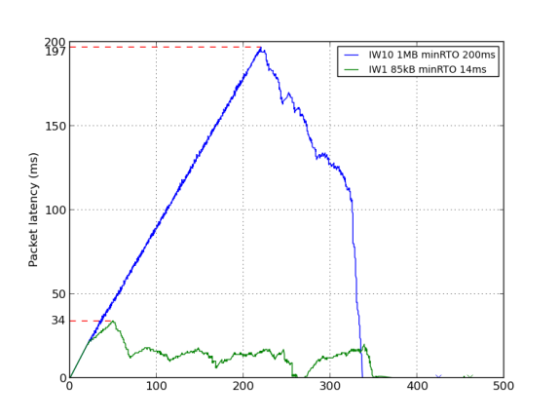
Converged and Adaptive Resource Provisioning
Adaptive -> measurement-based
Multipath and non-shortest-path routing based on utilisation and to control routing state overheads
TCP connection establishment based on shared state and temporal utilisation during
Converged
VM migration based on network cost minimisation
Cross-layer, network-wide multipathing
Challenges
Timescales: adaptivity vs. stability; long vs. mice flows
Centralised vs. distributed intelligence and control
Application awareness in transport
Appropriate control-plane mechanisms
SDN –good demonstrator but the operational paradigm limited
NFV – generalisation of a programmable control plane for fast service deployment

Slide 4
Papers
Tso, F.P., and Pezaros, D.P. (2013) Improving data centre network utilisation using near-optimal traffic engineering. IEEE Transactions on Parallel and Distributed Systems (IEEE TPDS), 24 (6). pp. 1139-1148. ISSN 1045-9219. June 2013.
Tso, F.P., Hamilton, G., Weber, R., Perkins, C., and Pezaros, D. (2013) Longer is better: exploiting path diversity in data center networks. In: IEEE International Conference on Distributed Computing Systems (IEEE ICDCS), 8-11 Jul 2013, Philadelphia, PA, USA.
Tso, F.P., Hamilton, G., Oikonomou, K., and Pezaros, D. (2013) Implementing scalable, network-aware virtual machine migration for cloud data centers. In: IEEE International Conference on Cloud Computing (IEEE CLOUD), 27 Jun - 02 Jul 2013, Santa Clara, CA, USA.
Jouet, S., and Pezaros, D. (2013) Measurement-Based TCP Parameter Tuning in Cloud Data Centers. In: IEEE International Conference on Network Protocols (IEEE ICNP), 7-11 October 2013, Gottingen, Germany
Varun Singh, Jörg Ott and Colin Perkins, Congestion Control for Interactive Media: Control Loops & APIs, Internet Architecture Board (IAB)/Internet Research Task Force (IRTF) Workshop on Congestion Control for Interactive Real-Time Communication, Vancouver, Canada, July 2012 http://csperkins.org/publications/2012/07/iab-cc-workshop.pdf
Stephen Strowes and Colin Perkins, Harnessing Internet Topological Stability in Thorup-Zwick Compact Routing, Proceedings of IEEE Infocom 2012 mini-conference, Orlando, FL, USA, March 2012.DOI:10.1109/INFCOM.2012.6195651
Paul Jakma, Marcin Orczyk, Colin Perkins, and Marwan Fayed, Distributed k-core Decomposition of Dynamic Graphs, Poster presented at the ACM CoNEXT Student Workshop, Nice, France, December 2012.DOI:10.1145/2413247.2413272

