Slide 1
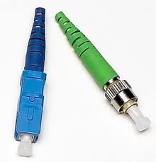
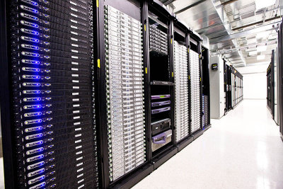
Terminating Terabits/s
Datacenters terminate our networks.
How do we design datacenters?
Importance?
Your <public-life, private-life, banks, government> live in my datacenter.
Do I need to labor the point?
Andrew W. Moore
Notes:
Please identify your research field; why is it strategic and growth area for research in the UK and beyond …?

Slide 2
Research Challenges
Tomorrow’s network needs will not work on current computers, network, architectures, or datacenter.
It doesn’t work that well today ….
What are the implications for end-hosts, computer systems, datacenters and
network-protocols
(as well as operating systems, and applications)
Expression and Control?
Isn’t your Multi-core machine a network?
Can it benefit from better control too?
Andrew W. Moore
Notes:
Future challenges and trends in your research field; What are the main research questions to answer in the next 5-10 years?

